Slide 1
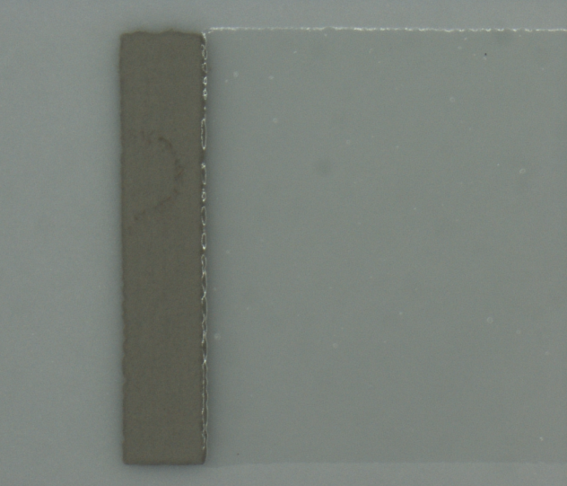
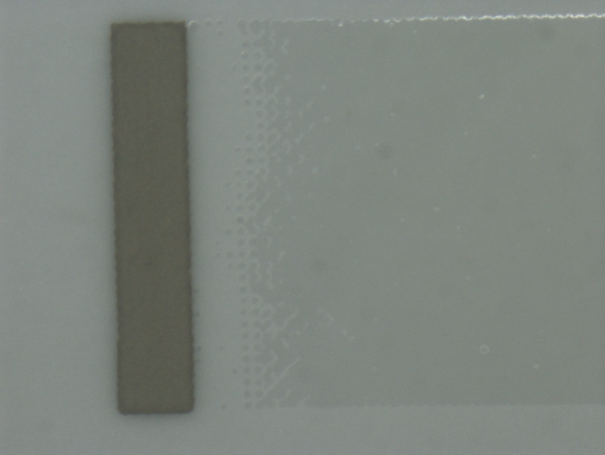

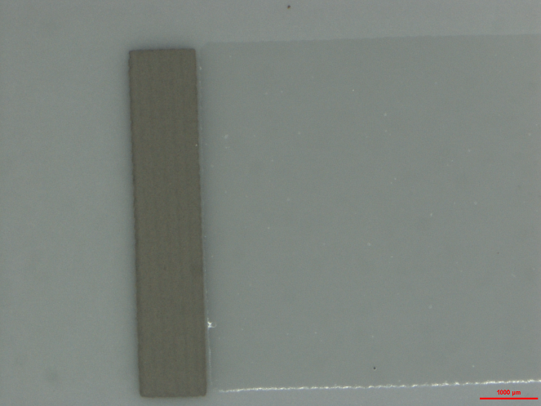
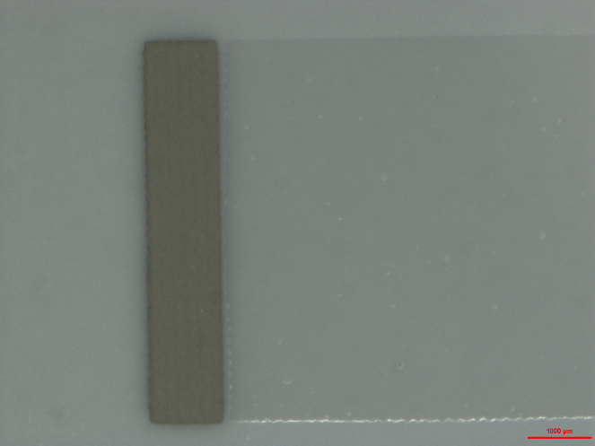


Printing direction
Gap
PZT
244T
Right side of the substrate underprinted
Slight overlap $≈$ good
Good
Tangent printing
Lateral printing
PZT
244T
Overlap
PZT
244T
Gap
Gap

Slide 2


Direction d’impression
Gap
PZT
244t
Sous-impression à gauche
L$éger recouvrement→$ OK
OK
Perpendiculaire au plot
PZT
244t
Impression latérale
Gap
Recouvrement
$$≈$$
PZT
244t
Gap

